Slide 1
Property, Plant and Equipment, and Intangible Assets - Accounting Principles
2022. 5.
Yangin Yoon

Slide 2
Agenda
Recap the previous class
Property, plant and equipment
Depreciation
- Depreciation Methods
- Change of Estimation
Derecognition
Capital expenditure vs. Income expenditure
Impairment
Intangible Assets

Slide 3
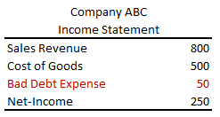
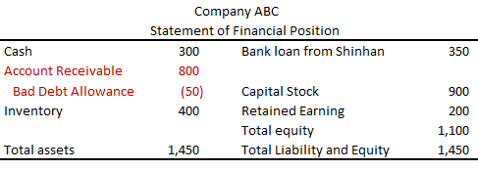
Recap the previous class
We evaluate the value of receivable periodically.
- If a customer is broken, or in trouble, we may not receive the promised amount of money from the customer. If so, we need to include this information in the financial statements.
Bad Debt Expense XXX
Allowance for Bad Debts XXX
* “Bad Debt Expense” is an expense type account.
“Allowance for Bad Debts” is an asset type account (A contra account to Accounts Receivable).

Slide 4
Recap the previous class
Finally, it is settled that the account receivable is paid by cash (all, some, or nothing).
- If the final decision is made, we remove (derecognize) the relevant accounts from our accounting book.
Cash XXX
Allowance for Bad Debts ZZZ
Bad Debt Expense YYY – XXX - ZZZ
Accounts Receivable YYY

Slide 5
Recap the previous class
ST Toy bought raw material from its supplier. ST Toy paid $200 to its supplier. In addition, ST Toy paid $80 to the factory workers as wage. The accounting department employees of ST Toy were also paid $40. ST Toy manufactured toys and used up all of its raw material. All transactions occurred with cash.
Paragraph 10 – “The cost of inventories shall comprise all costs of purchase, costs of conversion and other costs incurred in bringing the inventories to their present location and condition.”
Journal Entry
Raw material (asset) $200
Cash $200
Factory worker salary expense $80
Cash $80
Acct worker salary expense $40
Cash $40
Product (asset, inventory) $200
Raw material (asset) $200
Product (asset , inventory) $80
Factory worker salary expense $80

Slide 6
Recap the previous class
ST Toy bought raw material from its supplier. ST Toy paid $200 to its supplier. In addition, ST Toy paid $80 to the factory workers as wage. The accounting department employees of ST Toy were also paid $40. ST Toy manufactured toys and used up all of its raw material. All transactions occurred with cash.
The toys can be sold $100 in the market.
- Provide the general entry.
Paragraph 10 – “Inventories shall be measured at the lower of cost and net realisable value.”
Journal Entry
Inventory write-down (expense) $180
Product (asset) $180
Or
Inventory write-down (expense) $180
Accumulated loss (asset) $180

Slide 7
Any Questions?

Slide 8
Property, Plant and Equipment
For business operations, a company needs to have (and use) various assets.
- For example, companies need land, buildings, machines, cars, etc.
Some of assets are tangible, and the company directly use these assets for its business operation.
- These are different from inventories, financial assets, and intangible assets.

Slide 9
Property, Plant and Equipment
Initial Acquisition
- These items are recorded as an asset.
Machine AAA
Cash AAA
* “Machine” is an asset type account.
Building BBB
Cash BBB
* “Building” is an asset type account.
Car CCC
Cash CCC
* “Car” is an asset type account.
Land DDD
Cash DDD
* “Land” is an asset type account.

Slide 10
Depreciation
If we use PPE assets over the years, the values of PPE assets are changed.
- In most cases, the values are decrease.
- We cannot use machines or cars forever. For example, we can use them for 10 years or at most 20 years, depending on the situation.
→ So, we need to change the value of these assets.

Slide 11
Depreciation
ST Consulting bought a new car by paying $10,000 of cash on January 1st, 2022. ST Consulting guesses that it will use the car for 10 years. And after 10 years, ST Consulting thinks the car has no value (For example, used car dealers will not buy this car, because it has no value.)
- IAS 16, Paragraph 50 – “The depreciable amount of an asset shall be allocated on a systematic basis over its useful life.”
- IAS 16, Paragraph 60 – “ The depreciation method used shall reflect the pattern in which the asset’s future economic benefits are expected to be consumed by the entity.”
→ What is the required journal entry(entries) in each year?

Slide 12
Depreciation
ST Consulting bought a new car by paying $10,000 of cash on January 1st, 2022. ST Consulting guesses that it will use the car for 10 years. And after 10 years, ST Consulting thinks the car has no value (For example, used car dealers will not buy this car, because it has no value.)
Journal Entry
2022.1.1.
Car (asset) $10,000
Cash $10,000
2022.12.31.
Depreciation expense $1,000
Car (asset) $1,000
* “Depreciation expense” is an expense type account.
2023.12.31.
Depreciation expense $1,000
Car (asset) $1,000
2031.12.31.
Depreciation expense $1,000
Car (asset) $1,000

Slide 13
Depreciation
ST Consulting bought a new car by paying $10,000 of cash on January 1st, 2022. ST Consulting guesses that it will use the car for 10 years. And after 10 years, ST Consulting thinks the car has no value (For example, used car dealers will not buy this car, because it has no value.)
Journal Entry (Contra-asset account)
2022.1.1.
Car (asset) $10,000
Cash $10,000
2022.12.31.
Depreciation expense $1,000
Accumulated depreciation $1,000
* “Depreciation expense” is an expense type account. “Accumulated depreciation” is an asset type account.
2023.12.31.
Depreciation expense $1,000
Accumulated depreciation $1,000
2031.12.31.
Depreciation expense $1,000
Accumulated depreciation $1,000

Slide 14
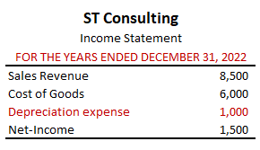
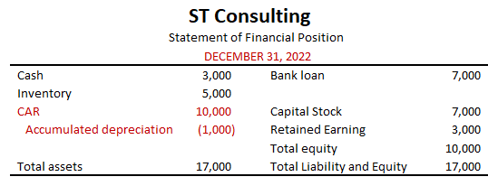
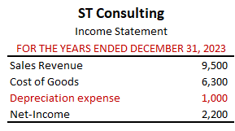
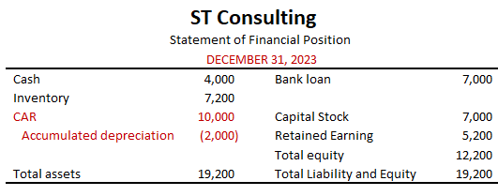
Depreciation
Financial Statements
2022
2023

Slide 15
Any Questions?

Slide 16
Depreciation - Variations
ST Consulting bought a new car by paying $10,000 of cash on January 1st, 2022. ST Consulting guesses that it will use the car for 10 years. And after 10 years, ST Consulting thinks the car has no value. (For example, used car dealers will not buy this car, because it has no value.)
Other Assumptions (Accounting Estimation)
- Estimated Residual Value (Salvage Value)
: If the car is expected to be sold for $3,000 after 10 years, then?
→ Annual depreciation amount = (10,000 – 3,000) / 10 = $800
- Estimated Useful life
: If the car is expected to be used for only 5 years, then?
→ Annual depreciation amount = (10,000 – 3,000) / 5 = $1,400

Slide 17
Derecognition (disposal)
ST Consulting bought a new car by paying $10,000 of cash on January 1st, 2022. ST Consulting guesses that it will use the car for 10 years. And after 10 years, ST Consulting thinks the car has no value. (For example, used car dealers will not buy this car, because it has no value.)
After 10 years, the company disposes the car. No cash is involved.
2031.12.31.
Depreciation expense $1,000
Accumulated depreciation $1,000
2031.12.31.
Accumulated depreciation $10,000
Car (asset) $10,000

Slide 18
Derecognition (disposal)
ST Consulting bought a new car by paying $10,000 of cash on January 1st, 2022. ST Consulting guesses that it will use the car for 10 years. And after 10 years, ST Consulting thinks the car has no value. (For example, used car dealers will not buy this car, because it has no value.)
After 10 years, the company disposes the car. ST Consulting sells the car for $500.
2031.12.31.
Depreciation expense $1,000
Accumulated depreciation $1,000
2031.12.31.
Accumulated depreciation $10,000
Cash $500
Car (asset) $10,000
Gain on disposal of cars $500
* “Gain on disposal of cars” is a revenue type account.

Slide 19
Derecognition (disposal)
ST Consulting bought a new car by paying $10,000 of cash on January 1st, 2022. ST Consulting guesses that it will use the car for 10 years. And after 10 years, ST Consulting thinks the car has no value. (For example, used car dealers will not buy this car, because it has no value.)
On June 30th, 2029, the company disposes the car. ST Consulting sells the car for $1,500.
2029.6.30.
Depreciation expense $500
Accumulated depreciation $500
2029.6.30.
Accumulated depreciation $7,500
Cash $1,500
Loss on disposal of cars $2,000
Car (asset) $10,000
* From 2022.1.1. to 2029.6.30. , it is 7.5 years.

Slide 20
Depreciation – Change of estimation
ST Consulting bought a new car by paying $10,000 of cash on January 1st, 2022. ST Consulting guesses that it will use the car for 10 years. And after 10 years, ST Consulting thinks the car has no value. (For example, used car dealers will not buy this car, because it has no value.)
On January 1st , 2024, the company re-estimates that it can use the car for 5 additional years. The residual value is $500.
2023.12.31.
Depreciation expense $1,000
Accumulated depreciation $1,000
2024.12.31.
Depreciation expense $1,500
Accumulated depreciation $1,500
* (10,000 – 1,000*2 - 500 ) / 5 =1,500
2025.12.31.
Depreciation expense $1,500
Accumulated depreciation $1,500

Slide 21
Capital expenditure vs. Income expenditure
ST Consulting bought a new building by paying $1,000,000 of cash on January 1st, 2022. ST Consulting guesses that it will use the building for 20 years. And after 20 years, ST Consulting thinks the building has no value.
Income expenditure
- On 2024. 1. 1., the company painted the building. It costs $1,000
2024.1.1.
Maintenance expense $1,000
Cash $1,000
* “Maintenance expense ” is an expense type account.
2024.12.31.
Depreciation expense $50,000
Accumulated depreciation $5,000
* (1,000,000 – 0 ) / 20 = 50,000

Slide 22
Capital expenditure vs. Income expenditure
ST Consulting bought a new building by paying $1,000,000 of cash on January 1st, 2022. ST Consulting guesses that it will use the building for 20 years. And after 20 years, ST Consulting thinks the building has no value.
Capital expenditure
- On 2024. 1. 1., the building has 10 office rooms. The company added 2 more rooms. The total cost is $72,000. The residual value is still zero.
2024.1.1.
Building $72,000
Cash $72,000
* “Building ” is an asset type account.
2024.12.31.
Depreciation expense $54,000
Accumulated depreciation $54,000
* (1,000,000 – 0 ) / 20 = 50,000
** (1,000,000 – 50,000 * 2 + 72,000 – 0 ) / (20 – 2) = 54,000

Slide 23
Any Questions?

Slide 24
Depreciation Methods
Depreciation and Accounting Standard
- IAS 16, Paragraph 50 – “The depreciable amount of an asset shall be allocated on a systematic basis over its useful life.”
- IAS 16, Paragraph 60 – “ The depreciation method used shall reflect the pattern in which the asset’s future economic benefits are expected to be consumed by the entity.”

Slide 25
Depreciation Methods
Straight-Line Method
- Assume that an asset will benefit all periods equally and that the cost should be assigned on a uniform basis for all periods.
Units-of-Production Depreciation
- Allocates an asset’s cost on the basis of use rather than time.
Accelerated Depreciation
- Methods that assign more depreciation to the earlier years and less to the later years. An asset’s carrying amount is multiplied by a constant depreciation rate.
© 2017 Cengage Learning, Principles of Financial Accounting, 2/E (IFRS Edition)

Slide 26

Depreciation Methods
ST Consulting bought a new car by paying $10,000 of cash on January 1st, 2022. It will use it for 5 years, and the estimated residual value is $500. The estimated total mileage is 200,000 km.
- The car is used for 30,000km (1st year), 60,000km (2nd year), 40,000km (3rd and 4th year), and 30,000km (5th year).
What is the depreciation amount in each year?
 | Straight-Line | Units-of-Production | Accelerated Depreciation
 |  |  | Carrying Book Value (A) | Depreciation Amount (A * 0.45)
1st year | 1,900 | 1,425 | 10,000 | 4,507
2nd year | 1,900 | 2,850 | 5,493 (=10000 – 4507) | 2,476
3rd year | 1,900 | 1,900 | 3,017 (=5493 – 2476) | 1,360
4th year | 1,900 | 1,900 | 1,657 | 747
5th year | 1,900 | 1,425 | 910 | 410
Total | 9,500 | 9,500 | 21,077 | 9,500
* 1 – $\sqrt[5]{\frac{500}{10000}}$ = 0.45
[or 10,000 * ${(1−0.45)}^{5}$ = 500 ]

Slide 27
Any Questions?

Slide 28
Impairment
ST Consulting bought a new building by paying $1,000,000 of cash on January 1st, 2022. ST Consulting guesses that it will use the building for 20 years. And after 20 years, ST Consulting thinks the building has no value.
Impairment
- On 2023. 12. 31., the recoverable amount of the building is 700,000. The estimated residual value and expected useful life are the same.
2023.12.31.
Depreciation expense $50,000
Accumulated depreciation $50,000
2023.12.31.
Impairment Loss $200,000
Accumulated Impairment Losses $200,000
* “Impairment Loss” is an expense type account.
“Accumulated Impairment Losses” is an asset type account (contra-asset).
* (1,000,000 – 0 ) / 20 = 50,000
** (1,000,000 – 50,000 * 2 + 72,000 – 0 ) / (20 – 2) = 54,000

Slide 29
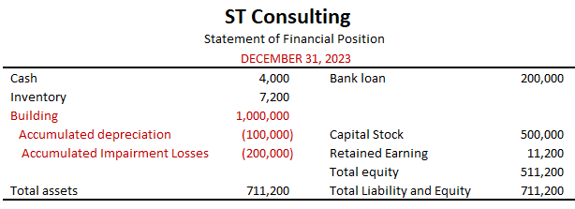
Impairment
ST Consulting bought a new building by paying $1,000,000 of cash on January 1st, 2022. ST Consulting guesses that it will use the building for 20 years. And after 20 years, ST Consulting thinks the building has no value.
Impairment
- On 2023. 12. 31., the recoverable amount of the building is 700,000. The estimated residual value and expected useful life are the same.
* (1,000,000 – 0 ) / 20 = 50,000
** (1,000,000 – 50,000 * 2 + 72,000 – 0 ) / (20 – 2) = 54,000

Slide 30
Any Questions?

Slide 31
Intangible Assets
Rights and privileges that are:
- Long-lived.
- Not held for resale.
- Have no physical substance.
- Providing owner with competitive advantage over other firms.
Internally Generated Intangible Assets
- They are not recognized on the balance sheet, but they have economical values.
Acquired Intangible Assets
- Valued at the amount paid to acquire them (e.g., patent, goodwill)
© 2017 Cengage Learning, Principles of Financial Accounting, 2/E (IFRS Edition)

Slide 32
Intangible Assets
Acquisition
- Recognized as the paid value
Amortization
- The process of cost allocation that assigns the original cost of an intangible asset to the periods benefited.
- Straight-line amortization is generally used.
- Directly written-off without contra-account (unlike depreciation)
Amortization Expense $5,000
Patent $5,000
* “Amortization Expense” is an expense type account.
“Patent” is an asset type account (intangible asset).

Slide 33
Chapter Summary
Property, plant and equipment
- Depreciation , Expected useful life, Expected residual value
- Change of estimation
Depreciation Methods
- Straight-Line Method, Units-of-Production Depreciation, Accelerated Depreciation
Capital Expenditure vs. Income Expenditure
Impairment
Intangible Assets

Slide 34
Any Questions?

Slide 35
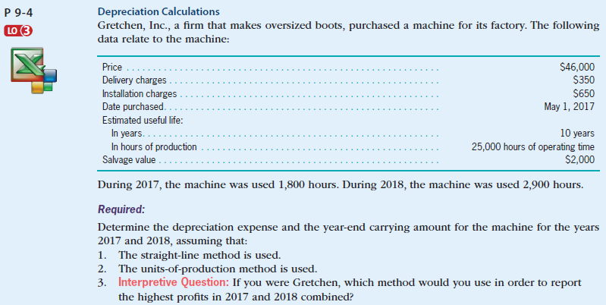
Depreciation (exercise)
Self-Study Material
© 2017 Cengage Learning, Principles of Financial Accounting, 2/E (IFRS Edition)

Slide 36
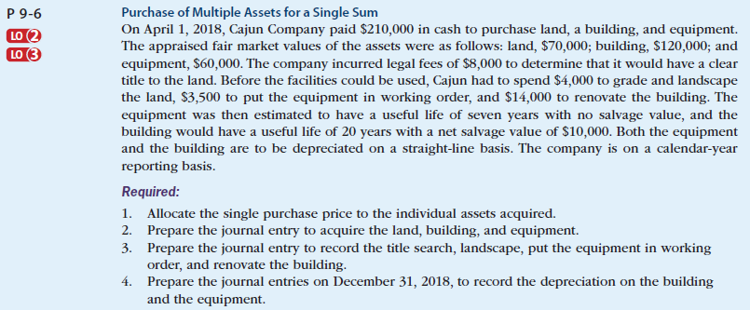
Depreciation (exercise)
Self-Study Material
© 2017 Cengage Learning, Principles of Financial Accounting, 2/E (IFRS Edition)

Slide 37
Any Questions?

Slide 38
Liabilities - Accounting Principles
2022. 5.
Yangin Yoon

Slide 39
Agenda
Recap the last class
Bond (Liability)
- Simplified
- Using Contra Account
Bonds Retirements before Maturity
Contingent Liability

Slide 40

Recap the last class (Financial Assets)
For example, the company gets $500 annually for three years, and $10,000 (principle) three years later.
- The current annual interest rate is 6%. What is the fair value of this cash flow?
→ Present value = $\frac{500}{{(1+0.06)}^{1}}$ + $\frac{500}{{(1+0.06)}^{2}}$ + $\frac{500}{{(1+0.06)}^{3}}$ + $\frac{10,000}{{(1+0.06)}^{3}}$= 9,733
 | 2022.1.1. | 2022.12. | 2023.12 | 2024.12 | Sum of three years
Nominal amount | 0 | 500 | 500 | 10,500 | 11,500
Interest rate | 0.06
Discount factor | 1 | 0.943 | 0.890 | 0.840
Present Value | 0 | 472 | 445 | 8,816 | 9,733

Slide 41
Recap the last class (Financial Assets)
2022.1.1.
2022.12.31.
9,733*0.06 = 584
2023.12.31.
9,817*0.06 = 589
 | Interest Income | Value before the interest payment (A) | Small payback (B) | Value after payment (C=A-B)
2022.1.1. | - | 9,733 |  | 9,733
2022.12.31. | 584 (=9,773 * 6%) | 10,317 (=9733*1.06) | 500 | 9,817
2023.12.31. | 589 (=9,817 * 6%) | 10,406 (=9817*1.06) | 500 | 9,906
2024.12.31. | 594 (=9,906 * 6%) | 10,500 (=9906*1.06) | 500 | 10,000
Financial Assets 9,733
Cash 9,733
Financial Assets 84
Cash 500
Interest income 584
Financial Assets 89
Cash 500
Interest income 589

Slide 42
Any Questions?

Slide 43

Bond (Liability)
One of the sources that a company borrow fund is bond.
Bond has three elements.
- Face value (principal amount)
- Coupon rate
- Maturity
The initial price is calculated by calculating the present value of future cash flow.
- When we calculate an NPV, we use an effective interest rate (market interest rate).

Slide 44
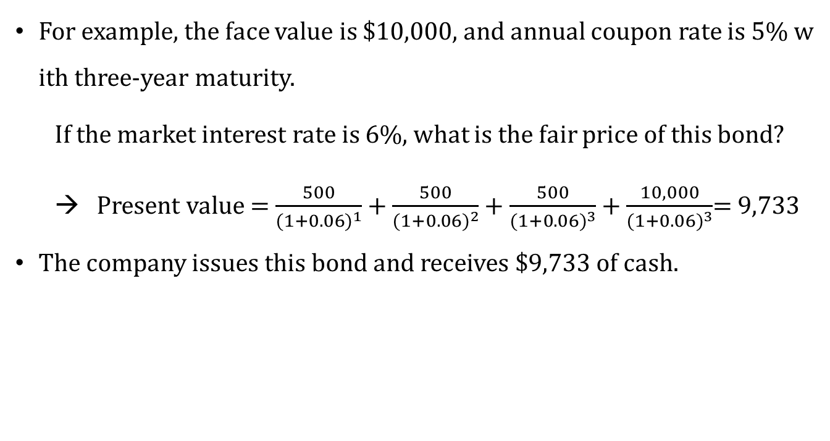
Bond (Liability)
For example, the face value is $10,000, and annual coupon rate is 5% with three-year maturity.
If the market interest rate is 6%, what is the fair price of this bond?
→ Present value = $\frac{500}{{(1+0.06)}^{1}}$ + $\frac{500}{{(1+0.06)}^{2}}$ + $\frac{500}{{(1+0.06)}^{3}}$ + $\frac{10,000}{{(1+0.06)}^{3}}$= 9,733
The company issues this bond and receives $9,733 of cash.
 | 2022.1.1. | 2022.12. | 2023.12 | 2024.12 | Sum of three years
Nominal amount | 0 | 500 | 500 | 10,500 | 11,500
Interest rate | 0.06
Discount factor | 1 | 0.943 | 0.890 | 0.840
Present Value | 0 | 472 | 445 | 8,816 | 9,733

Slide 45
Bond (Liability)
There are three main events:
1) Bond issuance
2) Interest payments
3) Principal payments
Cash YYY
Discount on Bonds Payable XXX- YYY
Bonds Payable XXX
Bond Interest Expense AAA
Cash BBB
Discount on Bonds Payable AAA - BBB
Bonds Payable XXX
Cash XXX

Slide 46
Bond (Liability) - Simplified
 | Effective Interest | Bond Value before Interest Payment | Coupon Amount | Bond Value after Payment
2022.1.1. | - | 9,733 |  | 9,733
2022.12.31. | 584 (=9,773 * 6%) | 10,317 (=9733*1.06) | 500 | 9,817
2023.12.31. | 589 (=9,817 * 6%) | 10,406 (=9817*1.06) | 500 | 9,906
2024.12.31. | 594 (=9,906 * 6%) | 10,500 (=9906*1.06) | 500 | 10,000
2022.1.1.
Cash 9,733
Bonds Payable 9,733
2022.12.31.
Bond Interest Expense 584
Cash 500
Bonds Payable 84
2022.12.31.
Bond Interest Expense 589
Cash 500
Bonds Payable 89
2022.12.31.
Bond Interest Expense 594
Bonds Payable 10,000
Cash 500
Bonds Payable 94
Cash 10,000

Slide 47
Bond (Liability) – Using Contra account
 | Effective Interest | Bond Value before Interest Payment | Coupon Amount | Bond Value after Payment
2022.1.1. | - | 9,733 |  | 9,733
2022.12.31. | 584 (=9,773 * 6%) | 10,317 (=9733*1.06) | 500 | 9,817
2023.12.31. | 589 (=9,817 * 6%) | 10,406 (=9817*1.06) | 500 | 9,906
2024.12.31. | 594 (=9,906 * 6%) | 10,500 (=9906*1.06) | 500 | 10,000
2022.1.1.
Cash 9,733
Discount on Bonds Payable 267
Bonds Payable 10,000
* “Discount on Bonds Payable” is a liability type account.
2022.12.31.
Bond Interest Expense 584
Cash 500
Discount on Bonds Payable 84
2022.12.31.
Bond Interest Expense 589
Cash 500
Discount on Bonds Payable 89
2022.12.31.
Bond Interest Expense 594
Bonds Payable 10,000
Cash 500
Discount on Bonds Payable 94
Cash 10,000
https://dart.fss.or.kr/dsaf001/main.do?rcpNo=20220317000816&dcmNo=8471591

Slide 48
Any Questions?

Slide 49
Bonds Retirements before Maturity
The ABC company pays $500 annually for three years, and $10,000 (principle) after three years.
- The current market interest rate is 6%
On 2023.12.31., after paying $500, the ABC company gets the bond by paying $9,950 from the bond market.
 | Effective Interest | Bond Value before Interest Payment | Coupon Amount | Bond Value after Payment
2022.1.1. | - | 9,733 |  | 9,733
2022.12.31. | 584 (=9,773 * 6%) | 10,317 (=9733*1.06) | 500 | 9,817
2023.12.31. | 589 (=9,817 * 6%) | 10,406 (=9817*1.06) | 500 | 9,906
2024.12.31. | 594 (=9,906 * 6%) | 10,500 (=9906*1.06) | 500 | 10,000
2022.12.31.
Bonds Payable 9,906
Loss on Bond Retirement 44
Cash 9,950
Or
2022.12.31.
Bonds Payable 10,000
Loss on Bond Retirement 44
Cash 9,950
Discount on Bonds Payable 94
* “Loss on Bond Retirement” is an expense type account (= “Losses on bond redemption”).

Slide 50
Contingent Liability
A potential liability that depends on the future outcome of past events.
- Possible obligation to be confirmed by a future event
- Present obligation that may/may not require outflow of resources
- Reliable estimate of amount of present obligation cannot be made
Examples: future liabilities that may arise due to lawsuits, tax disputes, or alleged violations of environmental protection laws.
https://dart.fss.or.kr/dsaf001/main.do?rcpNo=20220317000816&dcmNo=8471591

Slide 51
Any Questions?

Slide 52
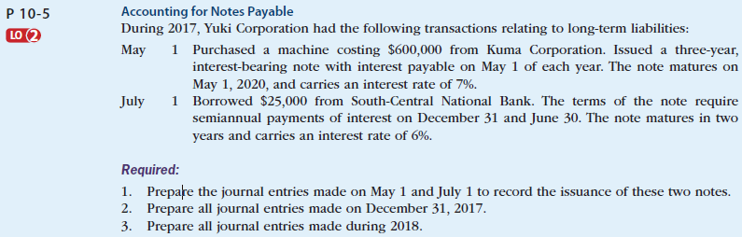
Liability (exercise)
Self-Study Material
© 2017 Cengage Learning, Principles of Financial Accounting, 2/E (IFRS Edition)

Slide 53
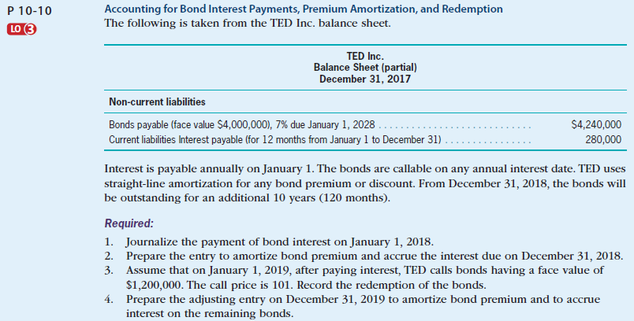
Liability (exercise)
Self-Study Material
© 2017 Cengage Learning, Principles of Financial Accounting, 2/E (IFRS Edition)

Slide 54
Any Questions?

